Slide 1
Project 3: Diabetes Risk Prediction and Treatment Pathways
Ibrahim Luqman
Jawad Haider

Slide 2
Overview
Problem Statement
The aim is to develop a system to assess patient risk for Type-2 diabetes both by the Standards of Care in Diabetes and the previously developed Diabetes Forecasting models. The feature engineering on these models can be revisited and improved based on clinical evidence. Also, depending upon the risk, a suitable treatment plan can be suggested to the patient.

Slide 3
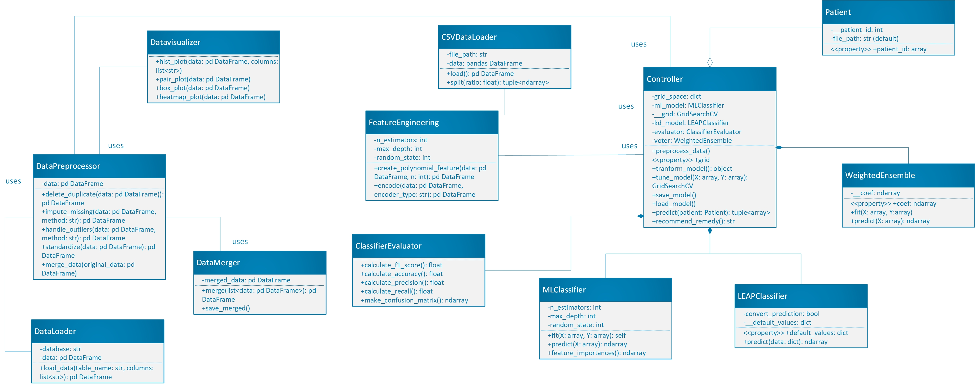
Overview
Class Diagram

Slide 4
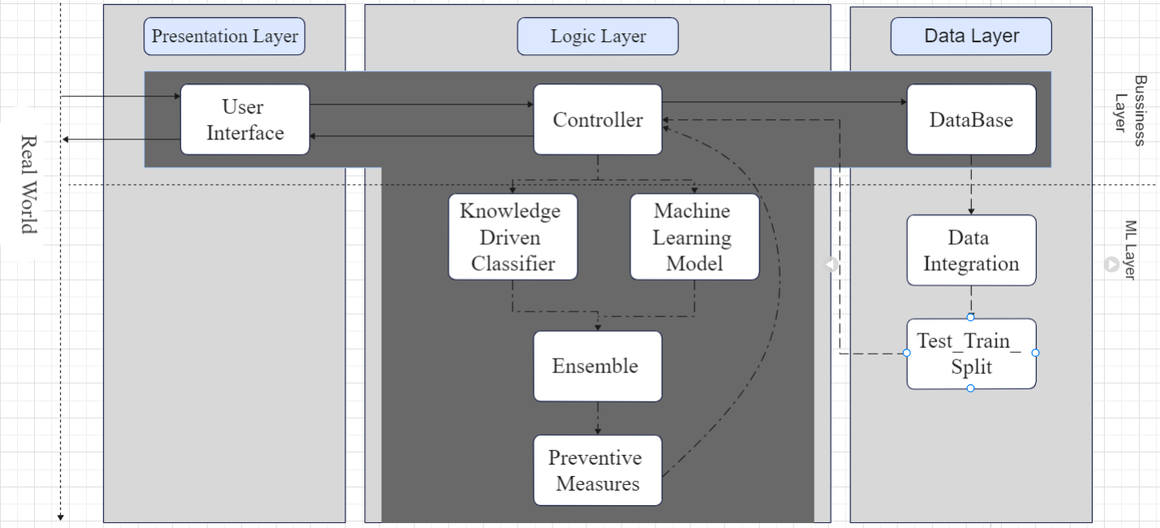
Overview
Architecture Diagram

Slide 5
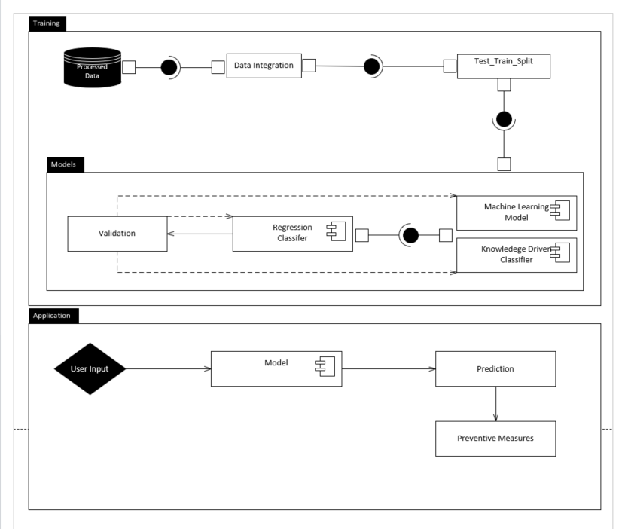
Overview
Component Diagram

Slide 6
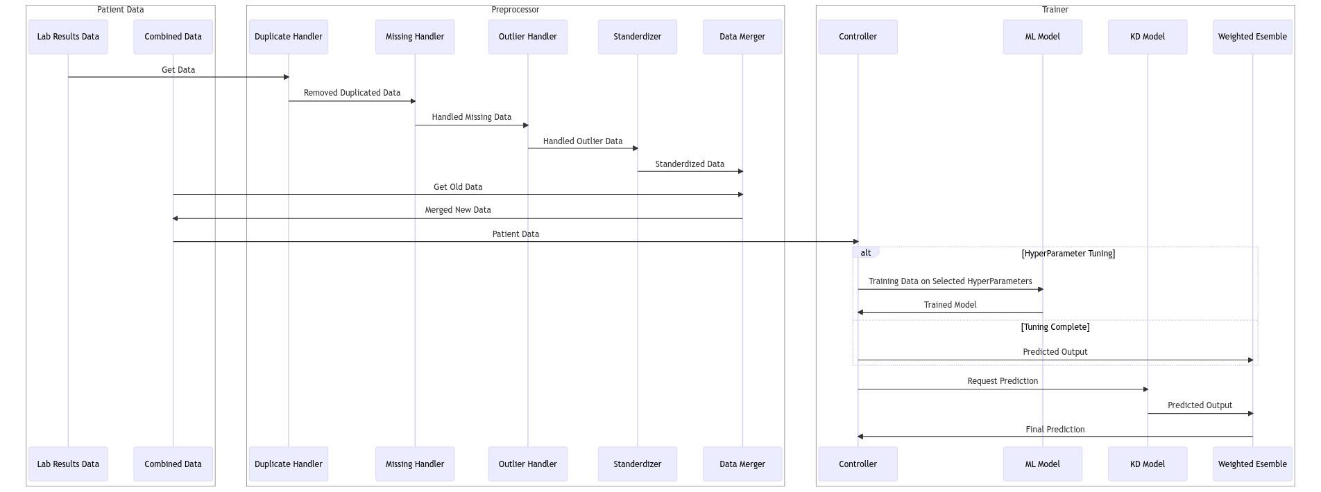
Overview
Sequence Training Diagram

Slide 7
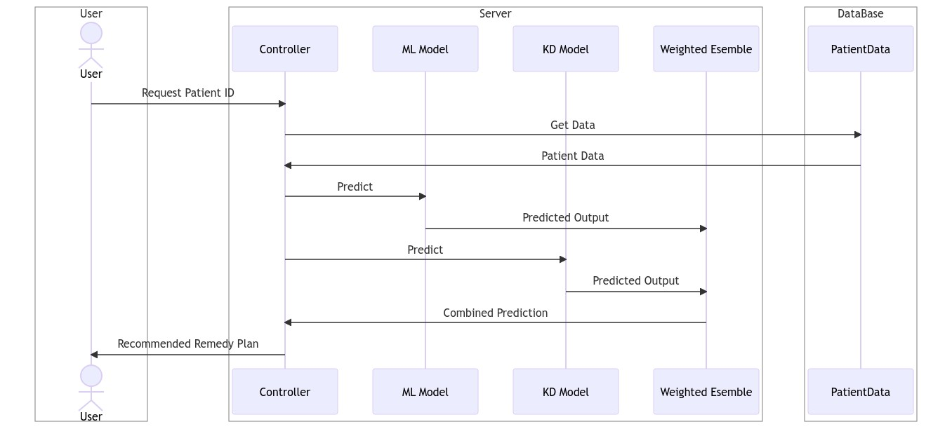
Overview
Sequence Prediction Diagram

Slide 8
Overview
THANK YOU

